Slide 1
Participants in #myDHis
26 August 2016

Slide 2
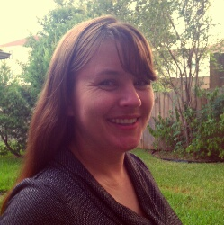
Laura Estill, Associate Professor, Department of English, TAMU, @Laura_Estill
Dr. Estill is an Associate Professor of English at Texas A&M University and editor of the World Shakespeare Bibliography (www.worldshakesbib.org). Her book, Dramatic Extracts in Seventeenth-Century English Manuscripts, appeared in 2015. She has articles in journals such as Shakespeare Quarterly, Shakespeare, Studies in English Literature, and Early Theatre. She is currently working on the TEI-based DEx: A Database of Dramatic Extracts. She has taught beginner and intermediate TEI at the Digital Humanities Summer Institute (DHSI) at the University of Victoria. Dr. Estill enjoys both teaching for and learning from the
IDHMC’s programming4humanists.

Slide 3
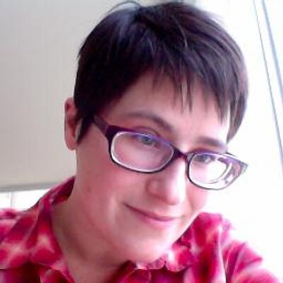
Shawna Ross, Assistant Professor, Department of English, TAMU
@ShawnaRoss
Dr. Ross is an Assistant Professor of modern British literature and the digital humanities at Texas A&M University. Her book project, Leisured Fictions: Working at Play in Transnational British Literature and Culture, argues that modernist literature theorized relations of leisure and labor, participating in the production of a comprehensive public discourse of leisure that challenged the Victorian work ethic and recognized the role of leisure in transnational economies and politics. Readings of Charles Dickens, G. K. Chesterton, Henry James, T. S. Eliot, E. M. Forster, Katherine Mansfield, Vita Sackville-West, and others are juxtaposed by archive-based studies in the visual history of the leisure industry. She frequently writes on Henry James and on the digital humanities, and her work has been published in The Henry James Review, the Journal of Modern Literature, Digital Humanities Quarterly, and various edited collections, including Henry James Today, Literary
Cartographies, and Utopianism, Modernism and Literature
in the Twentieth Century.

Slide 4
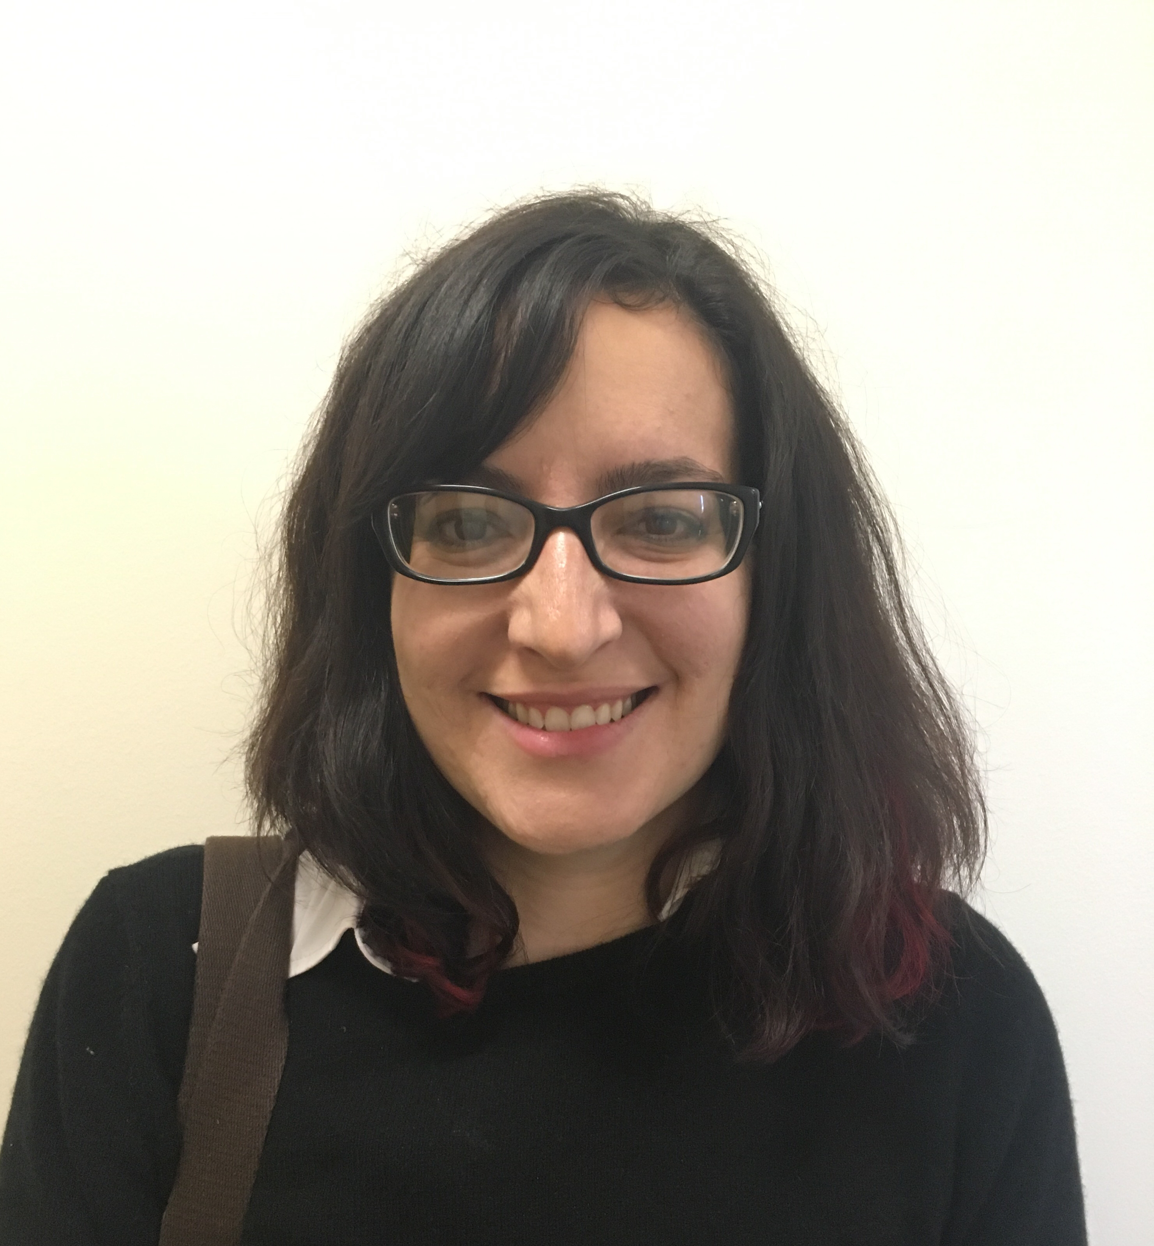
Katayoun Torabi, PhD Candidate, Department of English, TAMU,
Katayoun Torabi is a PhD candidate in the Department of English at Texas A&M University, specializing in Old and Middle English Literature and the Digital Humanities. Her research utilizes both computational and traditional analytical methods, and focuses on representations of pre- and post-mortem punitive spaces in medieval literature. Her work has been published in Essays in Medieval Studies and the Association for Computing Machinery Press. She is currently working on her dissertation, titled “Purgatory and Prison: Punitive Spaces in Old and Middle English Literature,” and completing a book chapter titled, “if ( not “Quantize, Click, and Conclude” ) { DigitalMethodsInMedievalStudies(); }” for an
edited collection that explores the practice of
digital humanities in medieval studies.

Slide 5
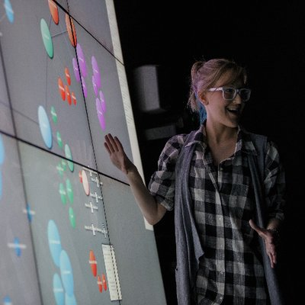
Liz Grumbach, Staff Research Associate of the IDHMC, TAMU
@EMGrumbach
Liz also serves as Project Manager for the Advanced Research Consortium (ARC) and 18thConnect.org. Liz provides technical support for the aggregation of peer-reviewed and proprietary metadata for ARC’s period-specific and thematic digital research environments, coordinates communication and software development, and organizes the sustainability plans for ARC projects. For 18thConnect, she manages the TypeWright document evaluation team and the peer review of scholarly, digital archives and projects. She is also the co-Project Manager for the Early Modern OCR Project (eMOP), and provides technical and research support for IDHMC faculty, staff, and graduate student projects at Texas A&M University. Liz has given several workshops on using OpenRefine
to clean metadata, including a webinar for the
Texas Digital Humanities Consortium (TXDHC) and
an introductory Course for this IDHMC
programming4humanists course sequence.

Slide 6
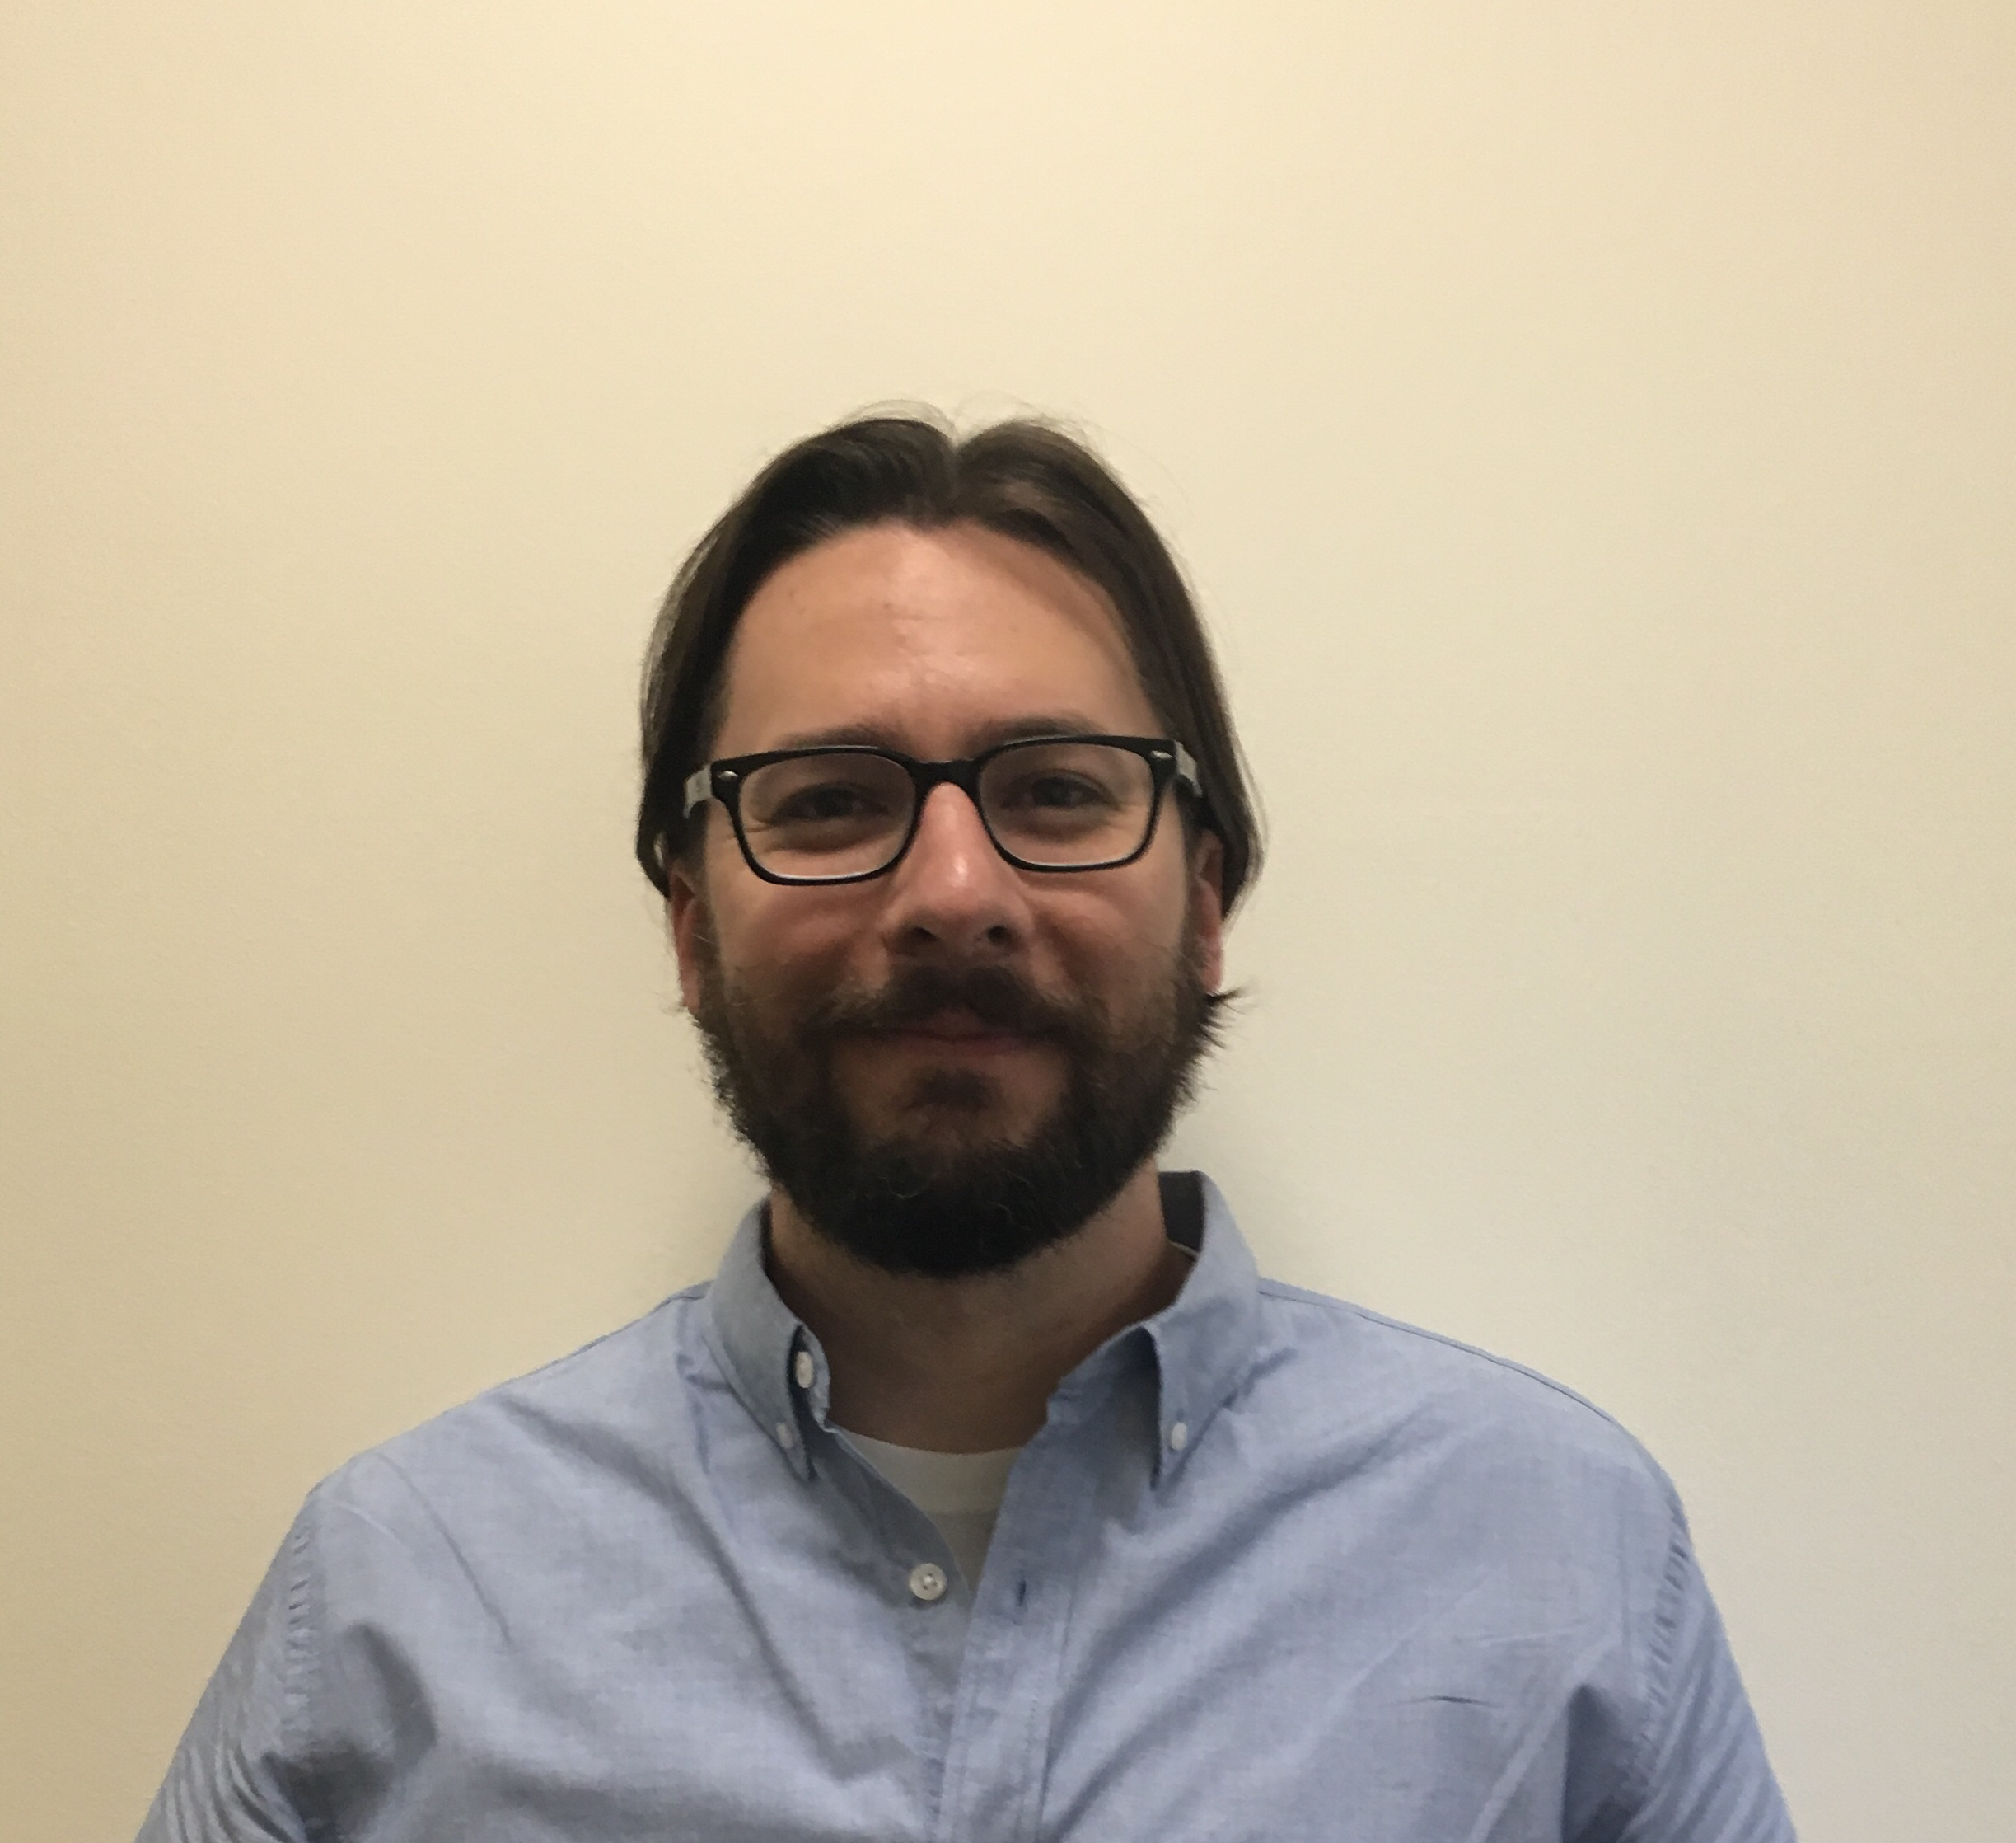
Bryan Tarpley, Lead Software Applications Developer of the IDHMC, TAMU
@HalyconFlies
Bryan develops software and provides technical support for projects at the IDHMC. He is also a Ph.D. student in the Department of English at Texas A&M, where he studies contemporary literature and theory, focusing on New Sincerity and the work of Zadie Smith and David Foster Wallace. He attained a degree in Computer Science in 2005, and has since worked as a software developer, systems administrator, and web designer while pursuing graduate degrees in the humanities. Having taught as a graduate assistant and adjunct, Bryan greatly enjoys finding approachable ways to convey complex material.

Slide 7
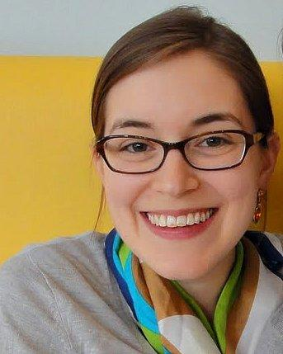
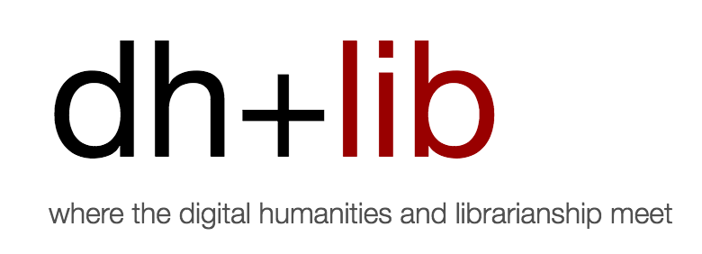
Sarah Potvin, Assistant Professor, University Libraries, TAMU, @sp_meta
Sarah is the Digital Scholarship Librarian, based in the Office of Scholarly Communications in the Texas A&M University Libraries. A founding editor of dh+lib (http://acrl.ala.org/dh), her research looks at sociotechnical and infrastructure issues, including the relationship between digital humanities and libraries/librarianship, the history and evolution of standards, and the political economy of scholarly communication efforts in libraries. She is currently working on articles on digital humanities preservation, community metadata standards as “clumsy solutions,” and digital asset management assessment.

Slide 8
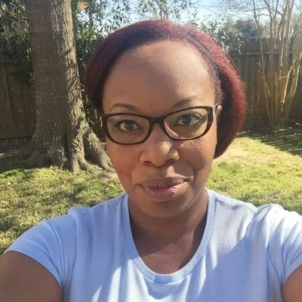
Toniesha L. Taylor, Associate Professor, Department of Languages and Communication, Prairie View A&M University, @DrTonieshaT
Dr. Taylor’s research foci is African American, Religion, Intercultural, Gender, and Digital Humanities. She has cultivated her interest throughout her doctoral work at Bowling Green State University where she completed her Ph.D. in Communication Studies with a focus on Rhetoric in 2009. Her research, conference presentations and publications speak to her diverse interest. Her recent research and conference presentations include discussions on womanist rhetoric as method and theory; practical social justice pedagogy for faculty and students; and digital humanities methods implications for activist recovery projects. Her recent publications include “Saving Sound,
Sounding Black and Voicing America: John Lomax and the
Creation of the “American Voice”” in Sounding Out!: The
Sound Studies Blog, June 8, 2015,
https://soundstudiesblog.com/2015/06/08/
john-lomax-and-the-creation-of-the-american-voice/
and a co-authored essay with Amy E. Earhart titled
“Pedagogies of Race: Digital Humanities in the Age of
Ferguson” in Debates in Digital Humanities, 2016, ed. by Lauren Klein and Matthew Gold. Dr. Taylor’s recent Digital Humanities projects include The Prairie View Women’s Oral History Project designed to collect, preserve, curate and display the oral histories of women who have had a thirty (30) year or longer relationship to Prairie View A&M University.

